Slide 1
LECTURE # 3
CHAPTER # 1

Slide 2
PREDICATE:
Statements involving variables,
such as
“x > 3,”
“x = y + 3,”
“x + y = z,”
“computer x is under attack by an intruder,”
“computer x is functioning properly,”
These statements are neither true nor false when the values of the variables are not specified.
The statement “x is greater than 3” has two parts.
The first part, the variable x, is the subject of the statement.
The second part—the predicate, “is greater than 3”.
We can denote the statement “x is greater than 3” by P (x),
The statement P (x) is also said to be the value of the propositional function P at x.
Once a value has been assigned to the variable x, the statement P (x) becomes a proposition and has a truth value.

Slide 3
METHOD OF SOLVING PREDICATE LOGIC
When the variables in a propositional function are assigned values, the resulting statement becomes a proposition with a certain truth value.
However, there is another important way,
propositional function
Quantifications

Slide 4
PREDICATE:
DEFINITION: A predicate is a sentence that contains a finite number of variables and becomes a statement when specific values are substituted for the variables. The domain of a predicate variable is the set of all values that may be substituted in place of the variable.
Consider the sentence
“Aslam is a student at the oxford University.”
let P stand for the words :- “is a student at the oxford University”
let Q stand for the words :- “is a student at.”
Then both P and Q are predicate symbols.
The sentences :
“x is a student at the “oxford University” and “x is a student at y” are symbolized as P(x) and Q(x, y),
where x and y are predicate variables and take values in appropriate sets.
When concrete values are substituted in place of predicate variables, a statement results.

Slide 5
EXAMPLES # 01
Let P (x) denote the statement “x > 3.” What are the truth values of P (4) and P (2)?
Solution:
We obtain the statement P (4) by setting x = 4 in the statement “x > 3.” Hence, P (4), which is the statement “4 > 3,” is true. However, P (2), which is the statement “2 > 3,” is false.
EXAMPLES # 02
Let
A(x) denote the statement “Computer x is under attack by an intruder.”
Suppose that of the computers on campus, only CS2 and MATH1 are currently under attack by intruders.
What are truth values of A(CS1), A(CS2), and A(MATH1)?
Solution:
We obtain the statement A(CS1) by setting x = CS1 in the statement “Computer x is under attack by an intruder.” Because CS1 is not on the list of computers currently under attack, we conclude that A(CS1) is false.
Similarly, because CS2 and MATH1 are on the list of computers under attack, we know that A(CS2) and A(MATH1) are true.

Slide 6
EXAMPLES # 03
Let Q(x, y) denote the statement “x = y + 3.” What are the truth values of the propositions Q(1, 2) and Q(3, 0)?
Solution:
To obtain Q(1, 2), set x = 1 and y = 2 in the statement Q(x, y).
Hence, Q(1, 2) is the statement “1 = 2 + 3,” which is false.
The statement Q(3, 0) is the proposition “3 = 0 + 3,” which is true.

Slide 7
Quantifiers
When the variables in a propositional function are assigned values, the resulting statement becomes a proposition with a certain truth value. However, there is another important way, called quantification,
Quantification expresses the extent to which a predicate is true over a range of elements.
In English, the words all, some, many, none, and few are used in quantifications.
We will focus on two types of quantification here:
1) universal quantification, which tells us that a predicate is true for every element under consideration
2) existential quantification, which tells us that there is one or more element under consideration for which the
predicate is true.
The area of logic that deals with predicates and quantifiers is called the predicate calculus.

Slide 8
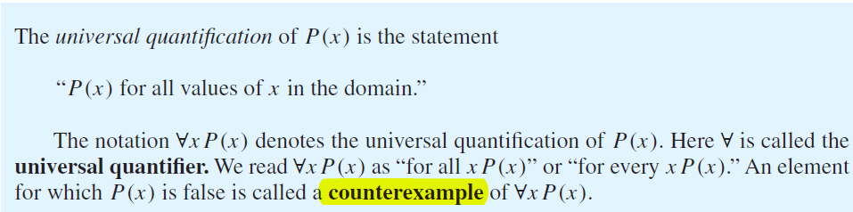
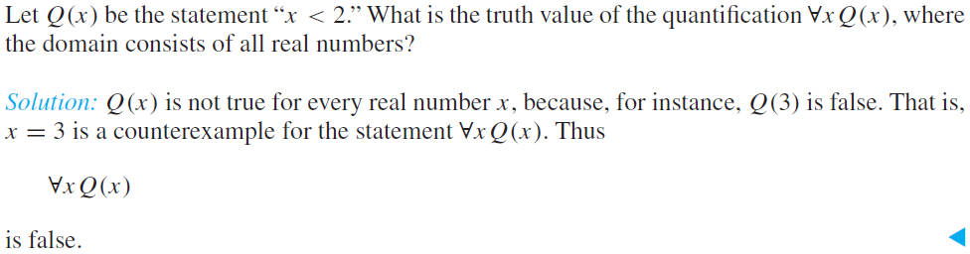
UNIVERSAL QUANTIFICATION
∀x P (x) is the same as the Conjunctions P (x1) ∧ P (x2) ∧ ··· ∧ P (xn),
EXAMPLES # 01

Slide 9
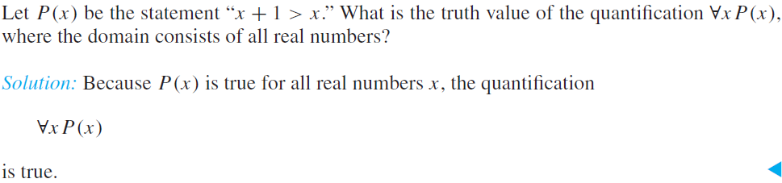
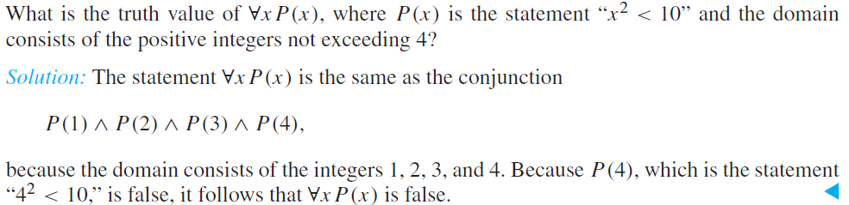
EXAMPLES # 01
EXAMPLES # 02

Slide 10
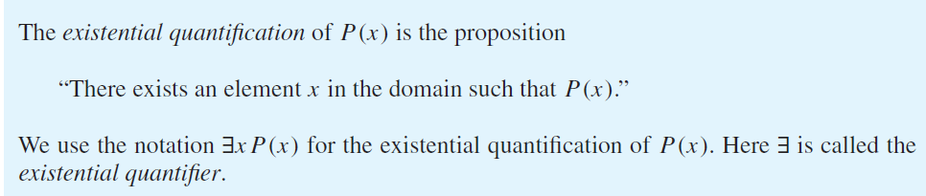
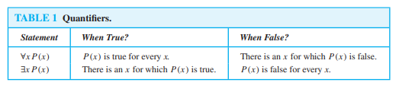
EXISTENTIAL QUANTIFICATION
∃xP (x) is the same as the disjunction P (x1) ∨ P (x2) ∨···∨ P (xn),

Slide 11
EXAMPLE # 1
Let P (x) denote the statement “x > 3.” What is the truth value of the quantification ∃xP (x), where the domain consists of all real numbers?
Solution:
Because “x > 3” is sometimes true—for instance, when x = 4—the existential quantification of P (x), which is ∃xP (x), is true.
EXAMPLE # 2
Let Q(x) denote the statement “x = x + 1.” What is the truth value of the quantification ∃xQ(x), where the domain consists of all real numbers?
Solution:
Because Q(x) is false for every real number x, the existential quantification of Q(x), which is ∃xQ(x), is false.

Slide 12
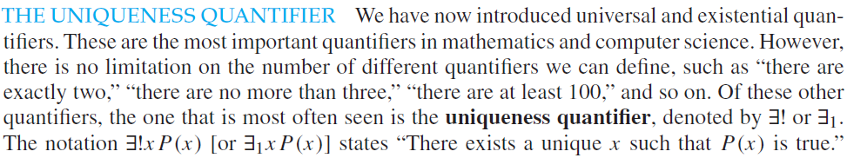
For instance, ∃!x(x − 1 = 0), where the domain is the set of real numbers, states that there is a unique real number x such that x − 1 = 0.
This is a true statement, as x = 1 is the unique real number such that x − 1 = 0.
Observe that we can use quantifiers and propositional logic to express uniqueness
so the uniqueness quantifier can be avoided.
Generally, it is best to stick with existential and universal quantifiers so that rules of inference for these quantifiers can be used

Slide 13
Precedence of Quantifiers The quantifiers ∀ and ∃ have higher precedence than all logical operators from propositional calculus.
Binding Variables When a quantifier is used on the variable x, we say that this occurrence of the variable is bound. An occurrence of a variable that is not bound by a quantifier or set equal to a particular value is said to be free.
All the variables that occur in a propositional function must be bound or set equal to a particular value to turn it into a proposition. This can be done using a combination of universal quantifiers, existential quantifiers, and value assignments.

Slide 14
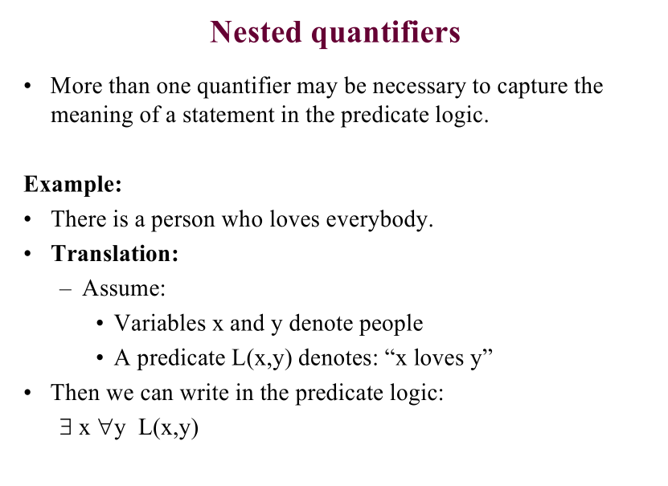

Slide 15
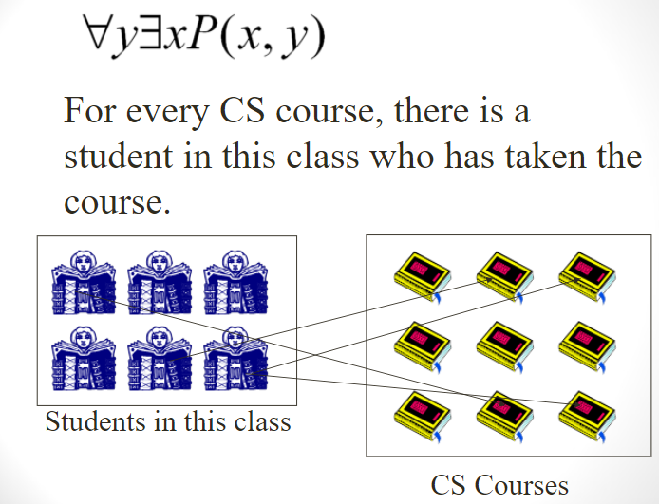

Slide 16
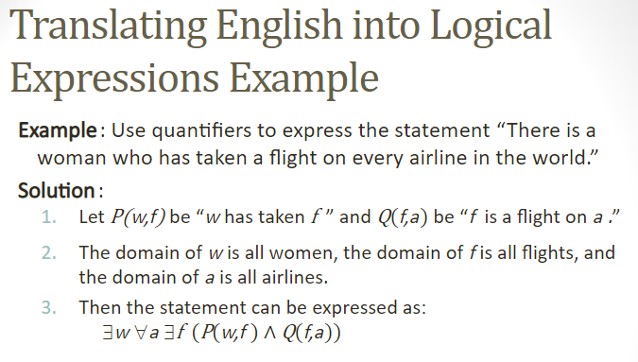

Slide 17
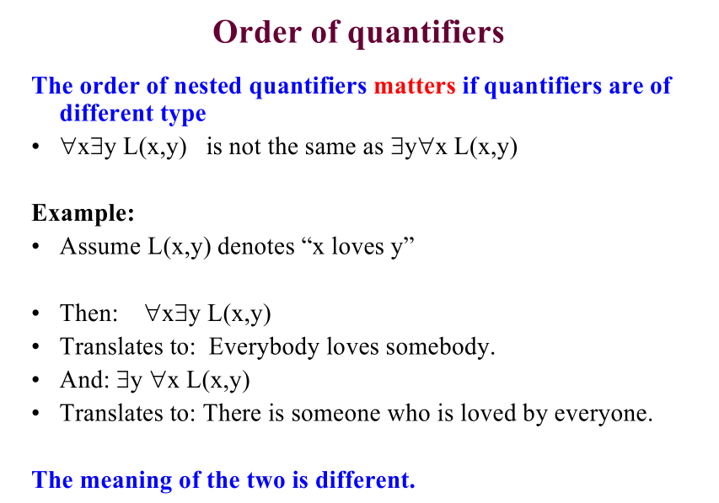

Slide 18
